Slide 1

Understanding AI Agents
By – bala gopal reddy peddireddy

Slide 2
Simple vs Complex Tasks for LLM Agents

Slide 3

Simple Task Example
Question: "Who won the ICC Cricket World Cup in 2019?“
Response: England won the ICC Cricket World Cup in 2019.

Slide 4
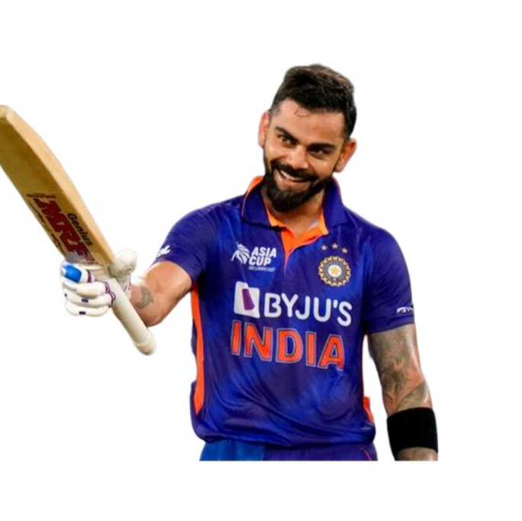
Complex Task Example
Question:
"Can you analyze the performance of Virat Kohli in ODIs over the last decade, compare it with other top batsmen, and provide insights on how his batting average has impacted India's success in World Cups?"

Slide 5
Complex Task Example Explanation
Breaking down the question into subcomponents
Accessing external data sources like cricket databases
Analyzing the data on batting averages
Using a code interpreter or tool to create a chart comparing the batting averages
Providing insights on how Kohli’s performance in ODIs correlates with India’s success in World Cups.

Slide 6
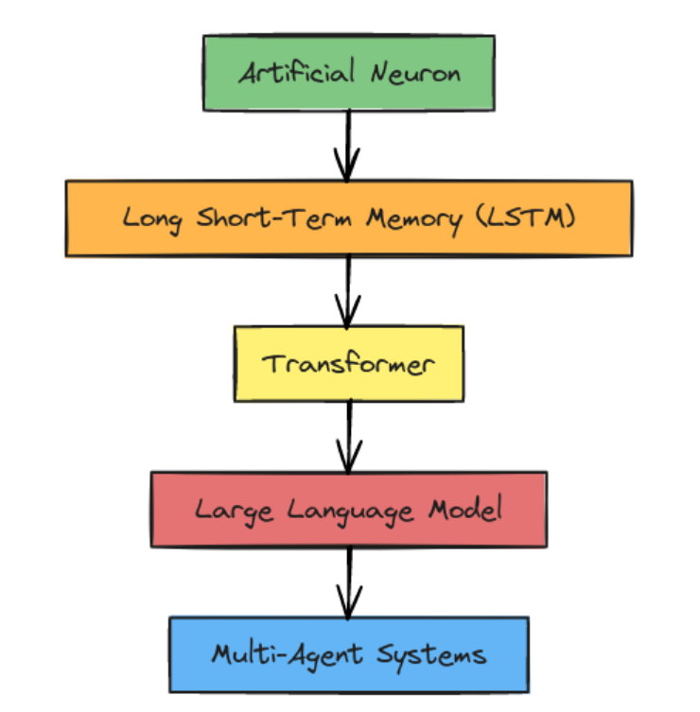
Evolution of AI Agents

Slide 7
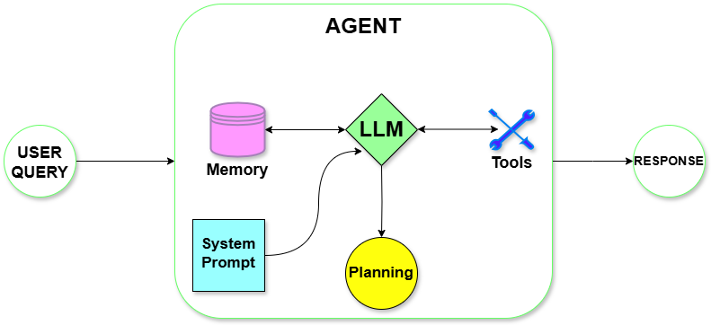
LLM Agent Framework

Slide 8
Planning for LLM Agents
Planning Without Feedback:
Chain of Thought
Tree of Thoughts
Planning With Feedback:
Refine its plan based on past actions and outcomes.
ReAct & Reflexion

Slide 9
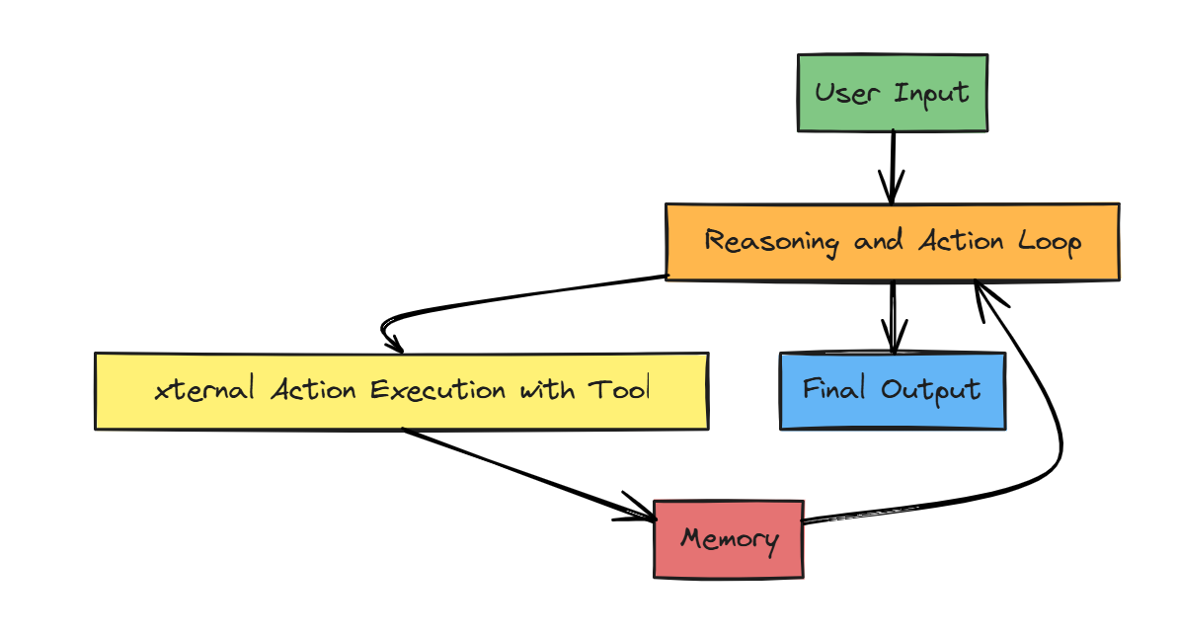
ReAct Agent Model

Slide 10
Example: Customer Support for E-commerce Order Issues
Consider a ReAct agent assisting a customer who is trying to track a delayed order.
Initial Query: The customer asks, "Where is my order? It was supposed to arrive yesterday."
First Reasoning Step: The agent reasons, "I need the order ID to locate the specific order details."
First Action Step: It asks the customer for their order ID.

Slide 11
Example: Customer Support for E-commerce Order Issues
Consider a ReAct agent assisting a customer who is trying to track a delayed order.
Initial Query: The customer asks, "Where is my order? It was supposed to arrive yesterday."
First Reasoning Step: The agent reasons, "I need the order ID to locate the specific order details."
First Action Step: It asks the customer for their order ID.

Slide 12
Example: Customer Support for E-commerce Order Issues
Consider a ReAct agent assisting a customer who is trying to track a delayed order.
Initial Query: The customer asks, "Where is my order? It was supposed to arrive yesterday."
First Reasoning Step: The agent reasons, "I need the order ID to locate the specific order details."
First Action Step: It asks the customer for their order ID.

Slide 13
Example: Customer Support for E-commerce Order Issues
Consider a ReAct agent assisting a customer who is trying to track a delayed order.
Initial Query: The customer asks, "Where is my order? It was supposed to arrive yesterday."
First Reasoning Step: The agent reasons, "I need the order ID to locate the specific order details."
First Action Step: It asks the customer for their order ID.

Slide 14
Example: Customer Support for E-commerce Order Issues
Second Reasoning Step: With the order ID, the agent thinks, "Now, I should check the shipping status to see if there’s any update on the order’s location."
Second Action Step: The agent accesses the shipping database, finding that the order is delayed due to weather conditions.
Third Reasoning Step: The agent then considers, "The customer would likely want an estimated arrival date. I should check if there’s an updated ETA from the shipping provider."
Third Action Step: After finding the estimated delivery date, the agent shares this with the customer and offers additional options (e.g., refund, store credit) if they wish to cancel.

Slide 15
Example: Customer Support for E-commerce Order Issues
Second Reasoning Step: With the order ID, the agent thinks, "Now, I should check the shipping status to see if there’s any update on the order’s location."
Second Action Step: The agent accesses the shipping database, finding that the order is delayed due to weather conditions.
Third Reasoning Step: The agent then considers, "The customer would likely want an estimated arrival date. I should check if there’s an updated ETA from the shipping provider."
Third Action Step: After finding the estimated delivery date, the agent shares this with the customer and offers additional options (e.g., refund, store credit) if they wish to cancel.

Slide 16
Example: Customer Support for E-commerce Order Issues
Second Reasoning Step: With the order ID, the agent thinks, "Now, I should check the shipping status to see if there’s any update on the order’s location."
Second Action Step: The agent accesses the shipping database, finding that the order is delayed due to weather conditions.
Third Reasoning Step: The agent then considers, "The customer would likely want an estimated arrival date. I should check if there’s an updated ETA from the shipping provider."
Third Action Step: After finding the estimated delivery date, the agent shares this with the customer and offers additional options (e.g., refund, store credit) if they wish to cancel.

Slide 17
Example: Customer Support for E-commerce Order Issues
Second Reasoning Step: With the order ID, the agent thinks, "Now, I should check the shipping status to see if there’s any update on the order’s location."
Second Action Step: The agent accesses the shipping database, finding that the order is delayed due to weather conditions.
Third Reasoning Step: The agent then considers, "The customer would likely want an estimated arrival date. I should check if there’s an updated ETA from the shipping provider."
Third Action Step: After finding the estimated delivery date, the agent shares this with the customer and offers additional options (e.g., refund, store credit) if they wish to cancel.

Slide 18
Example: Virtual Cincinnati Tour Guide
A ReAct agent serves as a virtual guide for a visitor in Cincinnati, providing personalized information about the city’s highlights based on visitor preferences.
Initial Query: A visitor asks, "Can you recommend some must-see attractions in Cincinnati?"
First Reasoning Step: The agent reasons, "To provide relevant recommendations, I should identify popular Cincinnati landmarks, like museums, parks, and historical sites."
First Action Step: It searches for top attractions in Cincinnati and finds options like the Cincinnati Zoo, the Cincinnati Art Museum, Smale Riverfront Park, and the National Underground Railroad Freedom Center.

Slide 19
Example: Virtual Cincinnati Tour Guide
A ReAct agent serves as a virtual guide for a visitor in Cincinnati, providing personalized information about the city’s highlights based on visitor preferences.
Initial Query: A visitor asks, "Can you recommend some must-see attractions in Cincinnati?"
First Reasoning Step: The agent reasons, "To provide relevant recommendations, I should identify popular Cincinnati landmarks, like museums, parks, and historical sites."
First Action Step: It searches for top attractions in Cincinnati and finds options like the Cincinnati Zoo, the Cincinnati Art Museum, Smale Riverfront Park, and the National Underground Railroad Freedom Center.

Slide 20
Example: Virtual Cincinnati Tour Guide
A ReAct agent serves as a virtual guide for a visitor in Cincinnati, providing personalized information about the city’s highlights based on visitor preferences.
Initial Query: A visitor asks, "Can you recommend some must-see attractions in Cincinnati?"
First Reasoning Step: The agent reasons, "To provide relevant recommendations, I should identify popular Cincinnati landmarks, like museums, parks, and historical sites."
First Action Step: It searches for top attractions in Cincinnati and finds options like the Cincinnati Zoo, the Cincinnati Art Museum, Smale Riverfront Park, and the National Underground Railroad Freedom Center.

Slide 21
Example: Virtual Cincinnati Tour Guide
A ReAct agent serves as a virtual guide for a visitor in Cincinnati, providing personalized information about the city’s highlights based on visitor preferences.
Initial Query: A visitor asks, "Can you recommend some must-see attractions in Cincinnati?"
First Reasoning Step: The agent reasons, "To provide relevant recommendations, I should identify popular Cincinnati landmarks, like museums, parks, and historical sites."
First Action Step: It searches for top attractions in Cincinnati and finds options like the Cincinnati Zoo, the Cincinnati Art Museum, Smale Riverfront Park, and the National Underground Railroad Freedom Center.

Slide 22
Example: Virtual Cincinnati Tour Guide
Second Reasoning Step: The agent considers, "The visitor might have specific interests. I should ask if they’re interested in history, outdoor activities, or arts and culture."
Second Action Step: It asks the visitor, "Are you interested in history, outdoor experiences, art, or a bit of everything?"
Third Reasoning Step: After the visitor responds with, "I love history and anything unique to Cincinnati," the agent reasons, "I should focus on historical sites and iconic Cincinnati experiences."
Third Action Step: The agent recommends the National Underground Railroad Freedom Center, sharing insights on Cincinnati’s role in the Underground Railroad, and suggests Findlay Market, one of the oldest public markets in Ohio with a unique history.

Slide 23
Example: Virtual Cincinnati Tour Guide
Second Reasoning Step: The agent considers, "The visitor might have specific interests. I should ask if they’re interested in history, outdoor activities, or arts and culture."
Second Action Step: It asks the visitor, "Are you interested in history, outdoor experiences, art, or a bit of everything?"
Third Reasoning Step: After the visitor responds with, "I love history and anything unique to Cincinnati," the agent reasons, "I should focus on historical sites and iconic Cincinnati experiences."
Third Action Step: The agent recommends the National Underground Railroad Freedom Center, sharing insights on Cincinnati’s role in the Underground Railroad, and suggests Findlay Market, one of the oldest public markets in Ohio with a unique history.

Slide 24
Example: Virtual Cincinnati Tour Guide
Second Reasoning Step: The agent considers, "The visitor might have specific interests. I should ask if they’re interested in history, outdoor activities, or arts and culture."
Second Action Step: It asks the visitor, "Are you interested in history, outdoor experiences, art, or a bit of everything?"
Third Reasoning Step: After the visitor responds with, "I love history and anything unique to Cincinnati," the agent reasons, "I should focus on historical sites and iconic Cincinnati experiences."
Third Action Step: The agent recommends the National Underground Railroad Freedom Center, sharing insights on Cincinnati’s role in the Underground Railroad, and suggests Findlay Market, one of the oldest public markets in Ohio with a unique history.

Slide 25
Example: Virtual Cincinnati Tour Guide
Second Reasoning Step: The agent considers, "The visitor might have specific interests. I should ask if they’re interested in history, outdoor activities, or arts and culture."
Second Action Step: It asks the visitor, "Are you interested in history, outdoor experiences, art, or a bit of everything?"
Third Reasoning Step: After the visitor responds with, "I love history and anything unique to Cincinnati," the agent reasons, "I should focus on historical sites and iconic Cincinnati experiences."
Third Action Step: The agent recommends the National Underground Railroad Freedom Center, sharing insights on Cincinnati’s role in the Underground Railroad, and suggests Findlay Market, one of the oldest public markets in Ohio with a unique history.

Slide 26

Memory in LLM Agents
Memory Types:
Short-term Memory
Long-term Memory
Hybrid Memory
Memory Formats:
Can include natural language, embeddings, or structured data like key-value stores.

Slide 27

Tools for LLM Agents
Examples:
Wikipedia Search API
Code Interpreter
Math Engine
Use Case: A code interpreter generates graphical representations (charts) to visualize obesity trends based on health data.

Slide 28
Thank You

